Slide 1
Analyzing the Impact of Car Features on Price and Profitability

Slide 2
PROJECT DESCRIPTION
The project aims to analyze the factors influencing car performance and market value, with success defined by customer preferences and sales trends.
The analysis will explore correlations between car specifications and variables like engine capacity, fuel efficiency, brand reputation, pricing, and market demand.
Data cleaning and preprocessing will be a crucial step to handle missing values, remove duplicates, and identify outliers.
The goal is to find key insights that can help predict market trends and improve decision-making in car manufacturing and sales.

Slide 3
TECH STACK USED
SOFTWARE:
EXCEL:
Excel is a powerful spreadsheet software used for data analysis, calculations, and visualization.
It allows users to create the table, charts, and graphs to organize and present data.
Excel has formulas, functions
It is widely used in finance, business, research, and education for managing large datasets for predicting the useful insights.

Slide 4
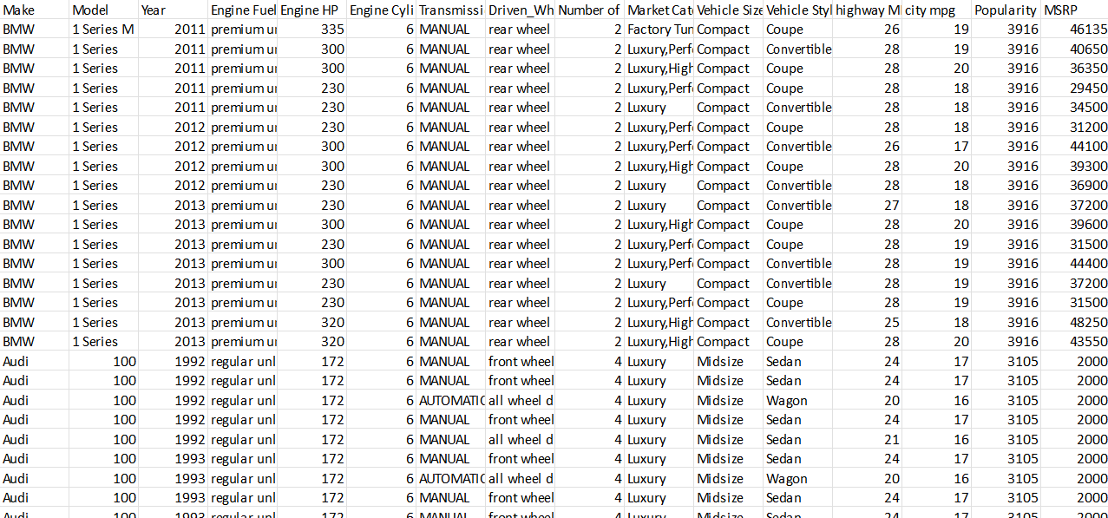
RAW DATA
It has 16 columns and 11915 records

Slide 5
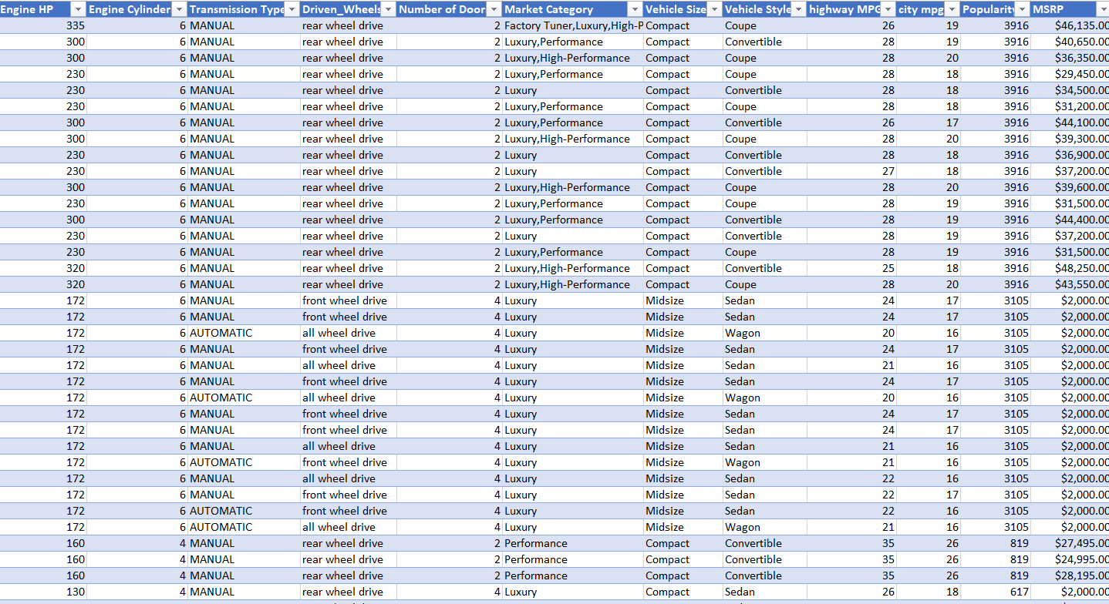
DATACLEANING
I have created a table for the given data
Using filter I checked the blank cells of each column and deleted that records .
Finally the cleaned data have 11813 records

Slide 6
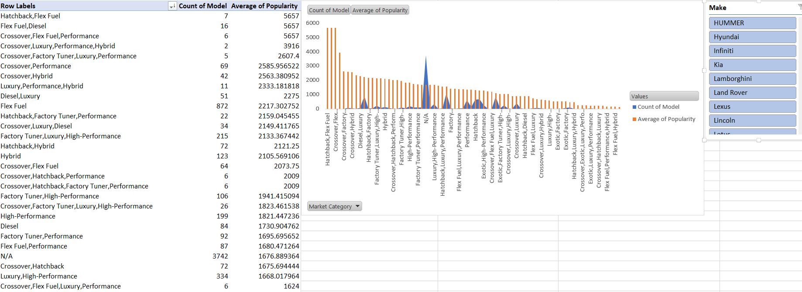
Data Analytics Tasks
1.Insight Required: How does the popularity of a car model vary across different market categories?
Task 1.A: Create a pivot table that shows the number of car models in each market category and their corresponding popularity scores.
Task 1.B: Create a combo chart that visualizes the relationship between market category and popularity.

Slide 7
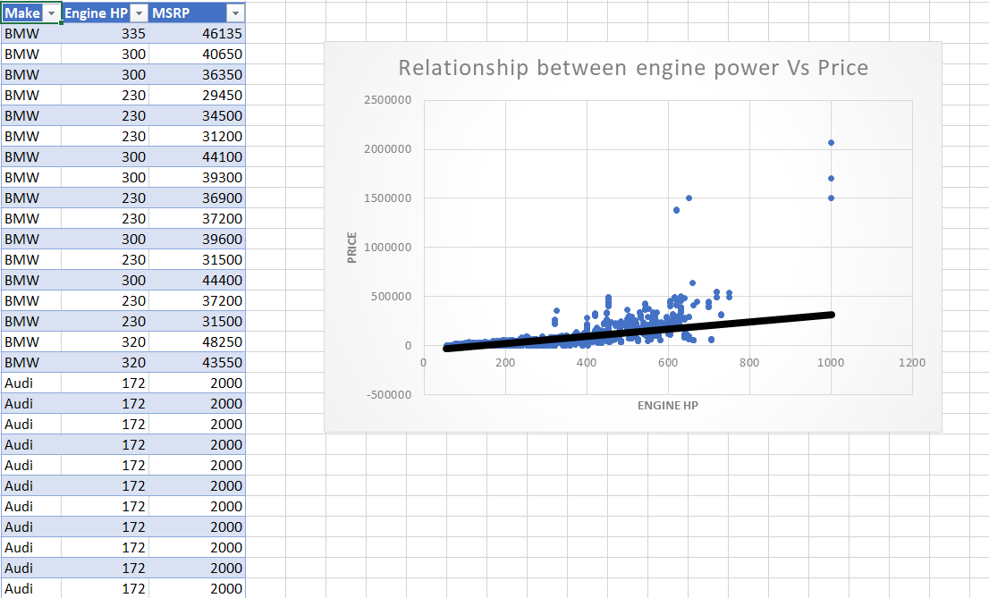
Data Analytics Tasks
2.Insight Required: What is the relationship between a car's engine power and its price?
Task 2: Create a scatter chart that plots engine power on the x-axis and price on the y-axis. Add a trendline to the chart to visualize the relationship between these variables.

Slide 8
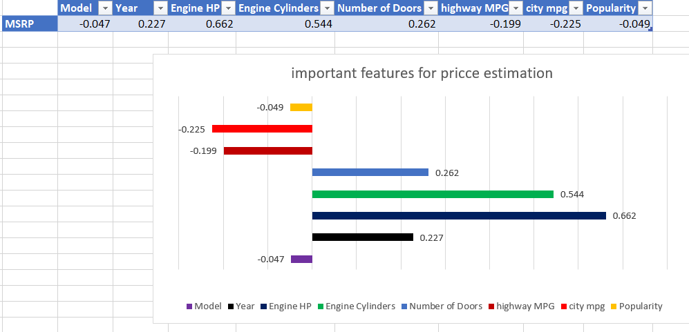
Data Analytics Tasks
3.Insight Required: Which car features are most important in determining a car's price?
Task 3: Use regression analysis to identify the variables that have the strongest relationship with a car's price. Then create a bar chart that shows the coefficient values for each variable to visualize their relative importance.

Slide 9
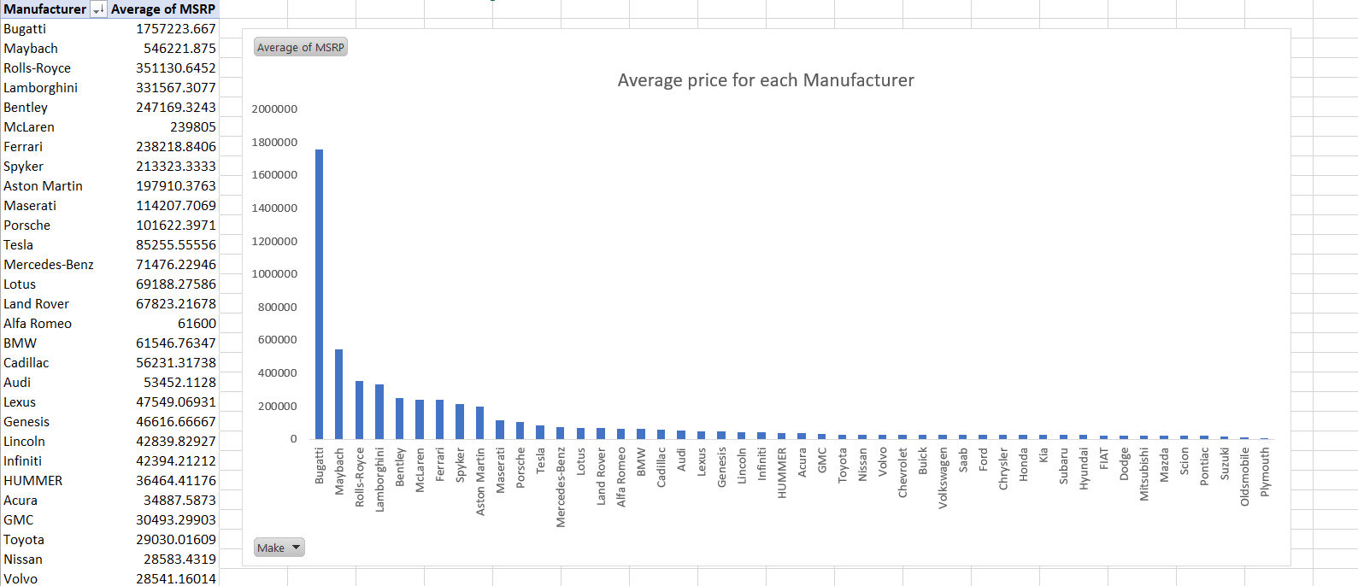
Data Analytics Tasks
4.Insight Required: How does the average price of a car vary across different manufacturers?
Task 4.A: Create a pivot table that shows the average price of cars for each manufacturer.
Task 4.B: Create a bar chart or a horizontal stacked bar chart that visualizes the relationship between manufacturer and average price.

Slide 10
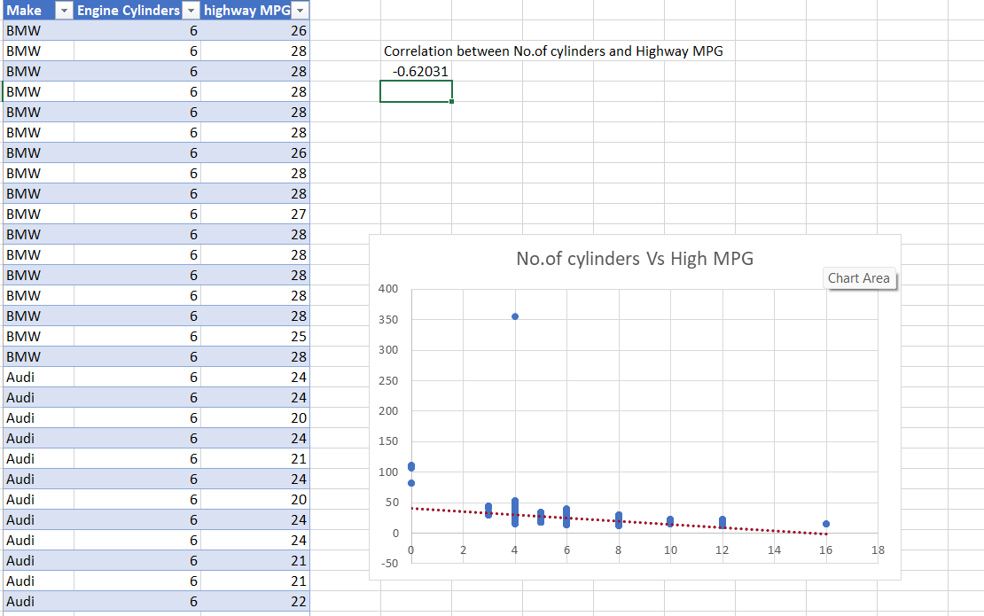
Data Analytics Tasks
5.Insight Required: What is the relationship between fuel efficiency and the number of cylinders in a car's engine?
Task 5.A: Create a scatter plot with the number of cylinders on the x-axis and highway MPG on the y-axis. Then create a trendline on the scatter plot to visually estimate the slope of the relationship and assess its significance.
Task 5.B: Calculate the correlation coefficient between the number of cylinders and highway MPG to quantify the strength and direction of the relationship.

Slide 11
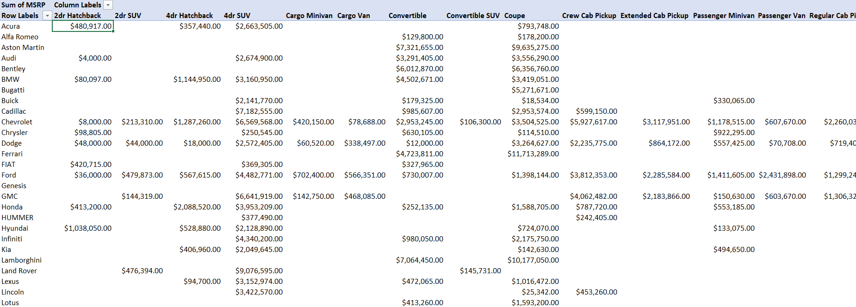
Building the Dashboard
Task 1: How does the distribution of car prices vary by brand and body style?(sum)

Slide 12
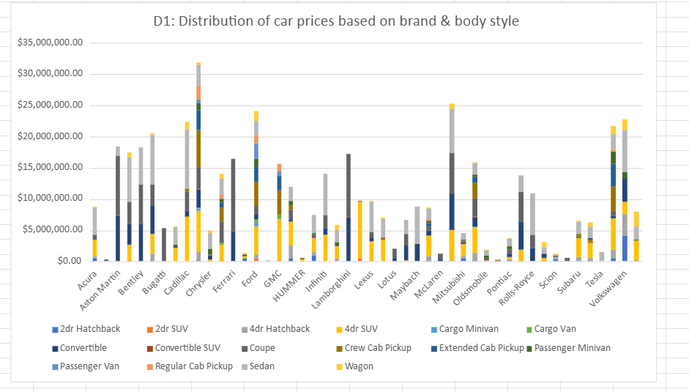

Slide 13
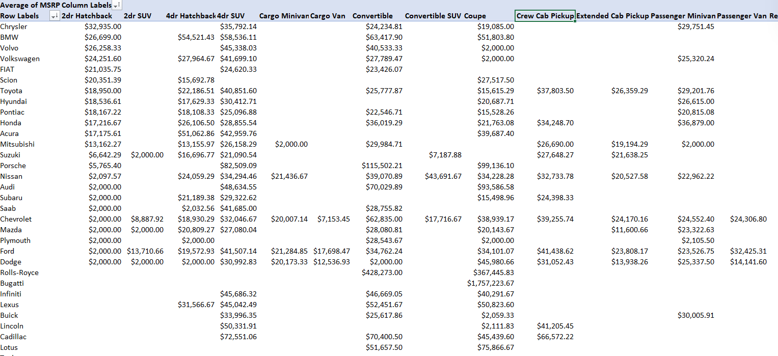
Building the Dashboard
Task 2: Which car brands have the highest and lowest average MSRPs, and how does this vary by body style?

Slide 14
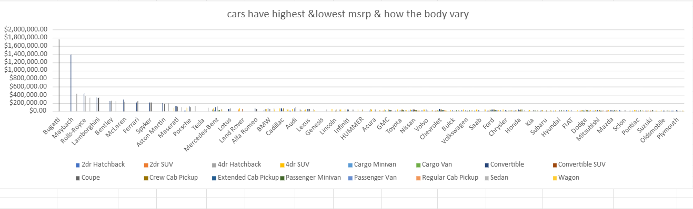

Slide 15
Building the Dashboard
Task 3: How do the different feature such as transmission type affect the MSRP, and how does this vary by body style?

Slide 16
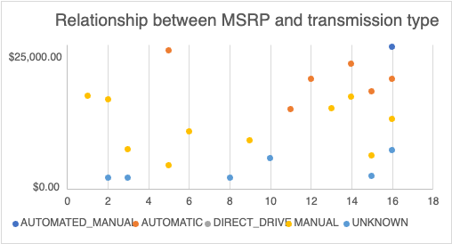
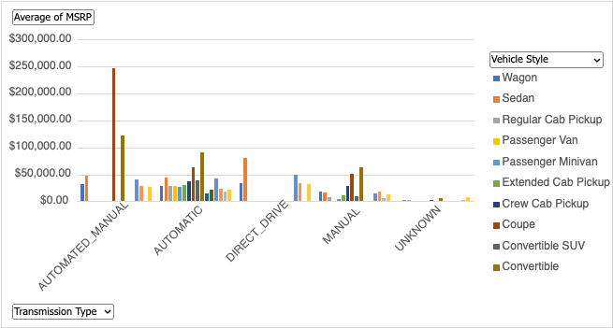

Slide 17
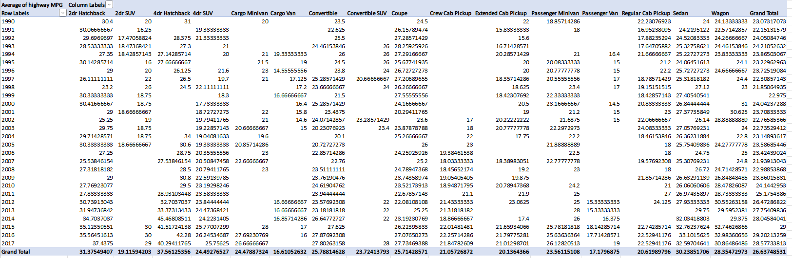
Building the Dashboard
Task 4: How does the fuel efficiency of cars vary across different body styles and model years?

Slide 18
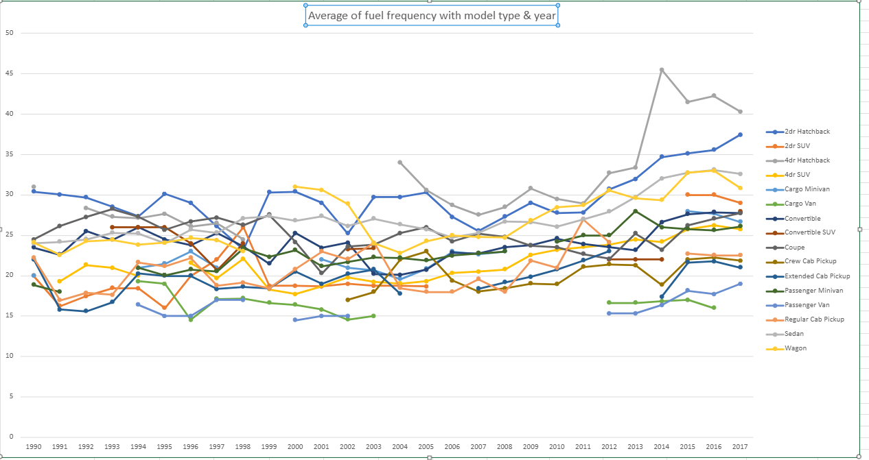

Slide 19
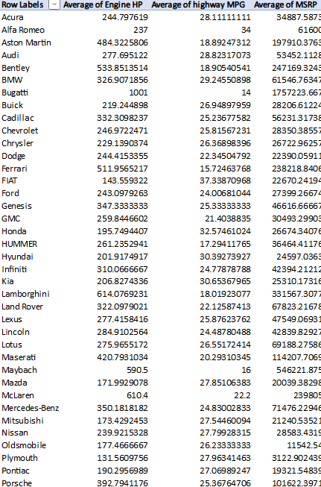
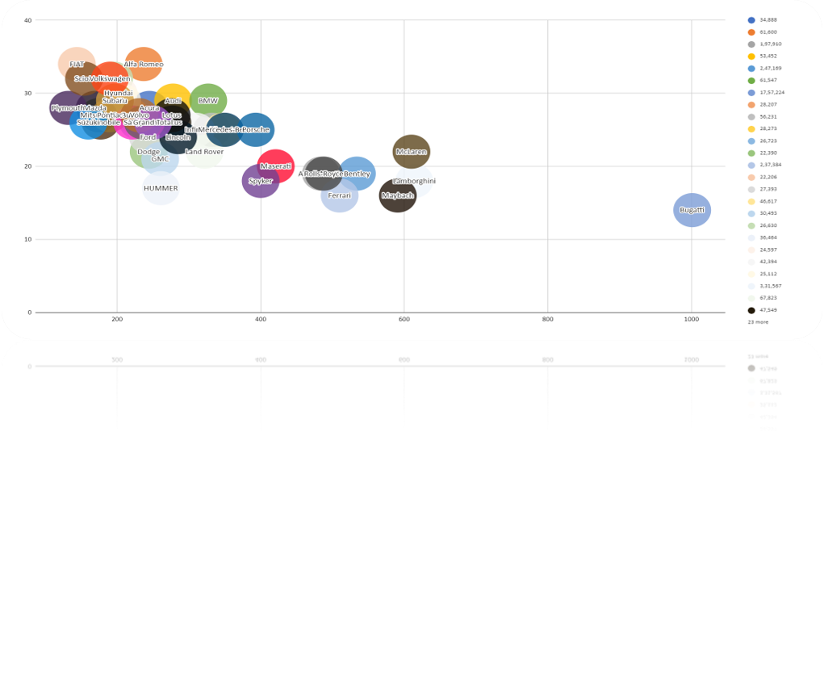
Building the Dashboard
Task 5: How does the car's horsepower, MPG, and price vary across different Brands?

Slide 20
INSIGHTS
A. Car Popularity Analysis: Checked which types of cars are the most popular in different market categories. This helped in understanding what kind of cars people prefer and why.
B. Engine Power vs. Price Analysis: Looked at how a car’s horsepower affects its price. By plotting engine power against price, we could see if more powerful cars are generally more expensive.
C. Feature Importance in Pricing: Analyzed which car features influence price the most. By running a regression analysis, we identified key factors like fuel type, transmission, and brand that impact the cost.
D. Manufacturer Pricing Analysis: Compared car prices across different brands to see which manufacturers have higher or lower average prices, helping to understand brand positioning in the market.
E. Fuel Efficiency vs. Engine Cylinders Analysis: Studied how the number of cylinders in a car's engine affects its fuel efficiency. This provided insights into the balance between power and mileage.
F. Interactive Dashboard Development: Designed a user-friendly dashboard in Excel with interactive filters and charts, making it easy to explore trends in pricing, popularity, and car features.

Slide 21
CONCLUSION
Excel is a great tool for data analysis, making it easy to clean, organize, and visualize large datasets.
Features like pivot tables, charts, and built-in functions help in quickly drawing meaningful insights.
With formulas and macros, complex tasks become more efficient and accurate.
This project helped in understanding car pricing, consumer preferences, and key factors that influence profitability in the market.
Reference link:
car_feature_excel

Slide 22
Thank you

